Slide 1
CSCE 689: Special Topics in Modern Algorithms for Data Science
Samson Zhou

Slide 2

Why Data Science?
Notes:
Enough about me, let’s talk about data science. Sources of big data are now universally present, across social media, financial markets, Internet of things, scientific data, so on and so forth, and thus understanding how to effectively and efficiently summarize the data is a crucial step toward both understanding past events as well as predicting future events.

Slide 3
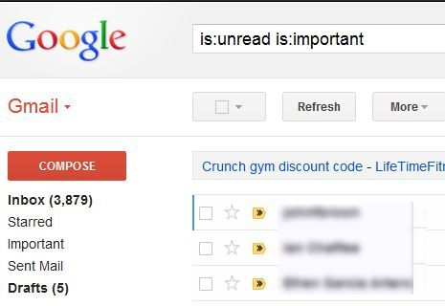
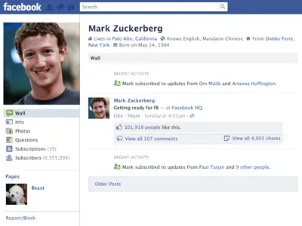

330 billion daily e-mails
3 billion monthly active users
8.5 billion daily Google searches

Slide 4
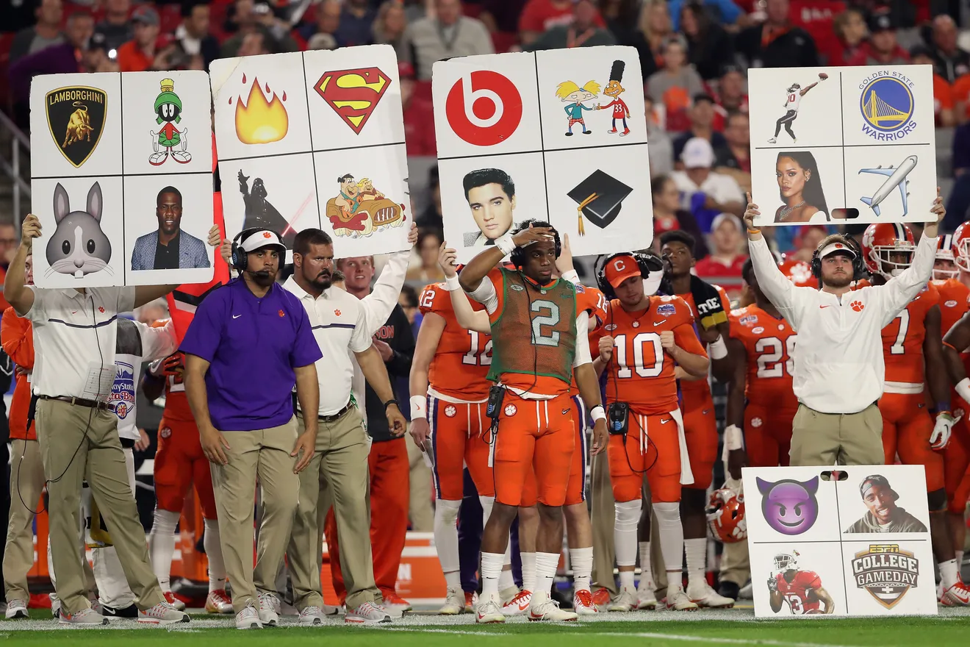

Slide 5








Slide 6
1 1 0 1 0 1
0

Slide 7
1 1 0 1 0 1
0 1 1 1 0 0
0
1
Notes:
Example: regression

Slide 8
1 1 0 1 0 1
0 1 1 1 0 0
0 1 0 1 1 1
0 1 1 0 1 0
1 0 1 1 1 1
0 1 1 1 0 1
0 0 1 0 1 1
0
1
1
0
0
1
0
Notes:
Example: regression

Slide 9




$$A$$
$$b$$
1 1 0 1 0 1
0 1 1 1 0 0
0 1 0 1 1 1
0 1 1 0 1 0
1 0 1 1 1 1
0 1 1 1 0 1
0 0 1 0 1 1
0
1
1
0
0
1
0
$$n$$
$$d$$
Notes:
Example: regression

Slide 10
$$A$$
$$b$$
1 1 0 1 0 1
0 1 1 1 0 0
0 1 0 1 1 1
0 1 1 0 1 0
1 0 1 1 1 1
0 1 1 1 0 1
0 0 1 0 1 1
0
1
1
0
0
1
0
$$n$$
$$d$$
Notes:
Example: regression

Slide 11
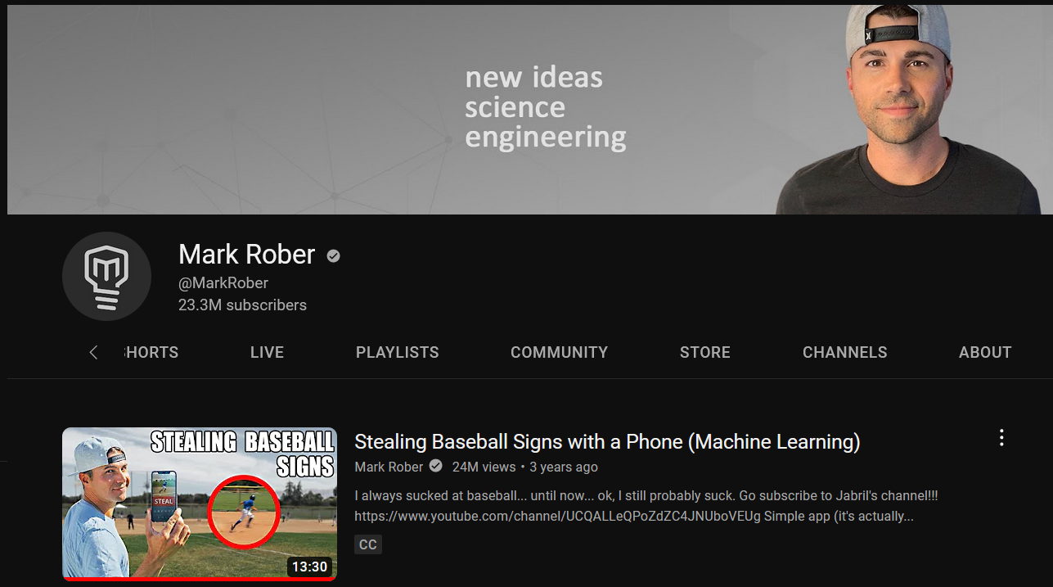

Slide 12


$$A$$
$$b$$
1 1 0 1 0 1
0 1 1 1 0 0
0 1 0 1 1 1
0 1 1 0 1 0
1 0 1 1 1 1
0 1 1 1 0 1
0 0 1 0 1 1
0
1
1
0
0
1
0
$$x$$
$$n$$
$$≈$$
$$d$$
Notes:
Example: regression

Slide 13
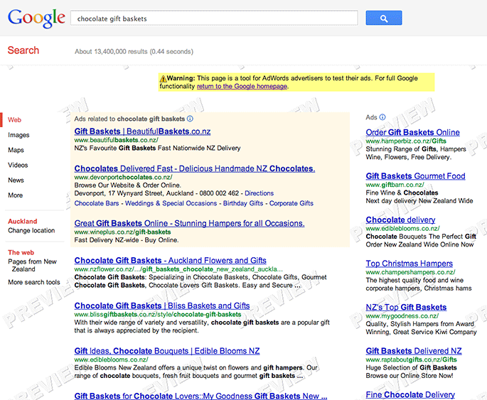

Slide 14
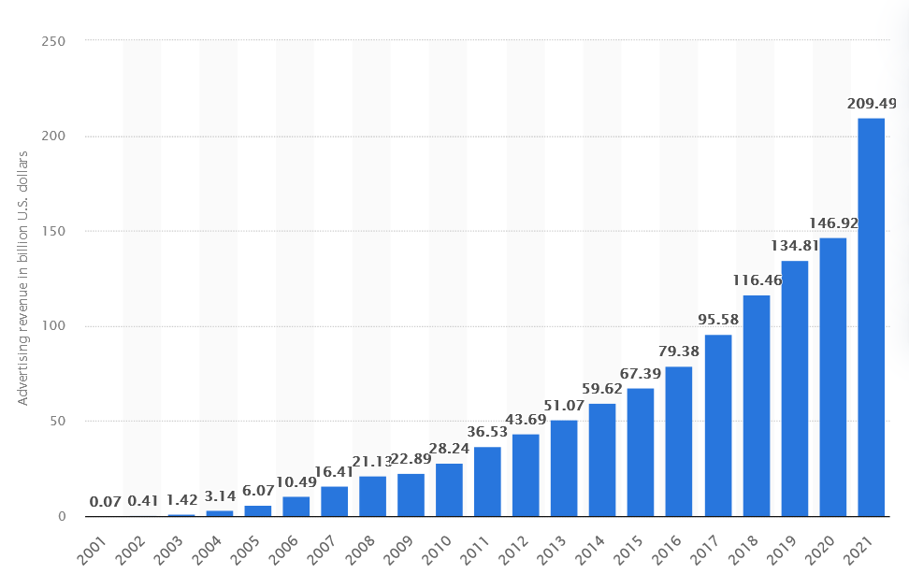

Google Ad Revenue (2001-2021, billion USD)

Slide 15
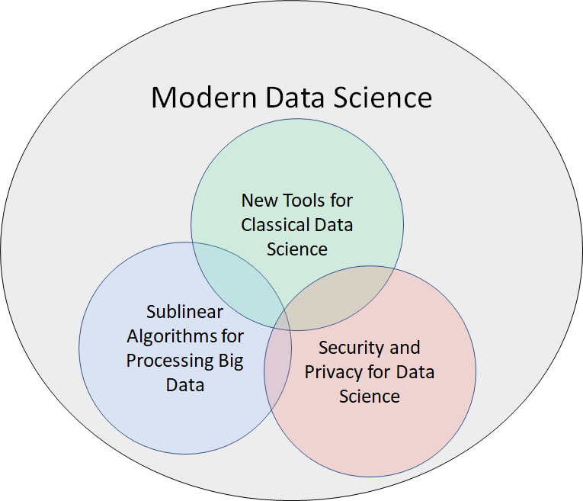
Evolving Demands
Sublinear-time or sublinear-space algorithms
Incorporation of advice
Security and privacy
Robustness to noise or adversarial input
Ability to handle time-sensitive data
Notes:
However, as the field of big data algorithms matures, we have realized that often implementing an algorithm to simply perform analysis is not enough; we might also require specific properties or functionality from the algorithm, such as sublinear-time or sublinear-space, incorporation of advice, security and privacy, robustness to noise or adversarial input, or the ability to handle time-sensitive data. These are crucial qualities that I’ve integrated into my research on algorithmic design and so throughout this talk as I summarize some of my broader work in each of the Venn diagram categories, I’ll also interleave discussion of these modern demands.

Slide 16
Modern Algorithms for Data Science
Algorithms for data science
Sublinear algorithms
Models of computation for big data
Differential privacy

Slide 17
Logistics
HRBB 126, MWF, 1:50-2:40 pm CT
Office Hours: PETR 424, 3 pm CT on Wednesdays
Course materials: https://samsonzhou.github.io/csce689-2023

Slide 18
Primary Goals
Describe the motivation and statement of central data science problems, measured by the midterm presentation
Work in various big data models of computation, leading toward the final project
Understand the fundamentals of private data analysis
Demonstrate awareness of common algorithmic techniques, through scribe notes

Slide 19
Secondary Goals
Describe the motivation and statement of central data science problems, measured by the midterm presentation (practice reading and presenting technical papers)
Work in various big data models of computation, leading toward the final project (practice thinking about research!)
Understand the fundamentals of private data analysis
Demonstrate awareness of common algorithmic techniques, through scribe notes (familiarity with LaTeX)

Slide 20
Grading
LaTeX summary of lectures 20%
Midterm presentation 35%
Final project 45%

Slide 21

Related Coursework
CSCE 689: Special Topics on Algorithms for Big Data
Taught by Professor Crawford
MWF 10:20-11:00 am, HRBB 126
Topics:
Streaming algorithms
Parallel algorithms
Sublinear time algorithms
Sketching algorithms

Slide 22
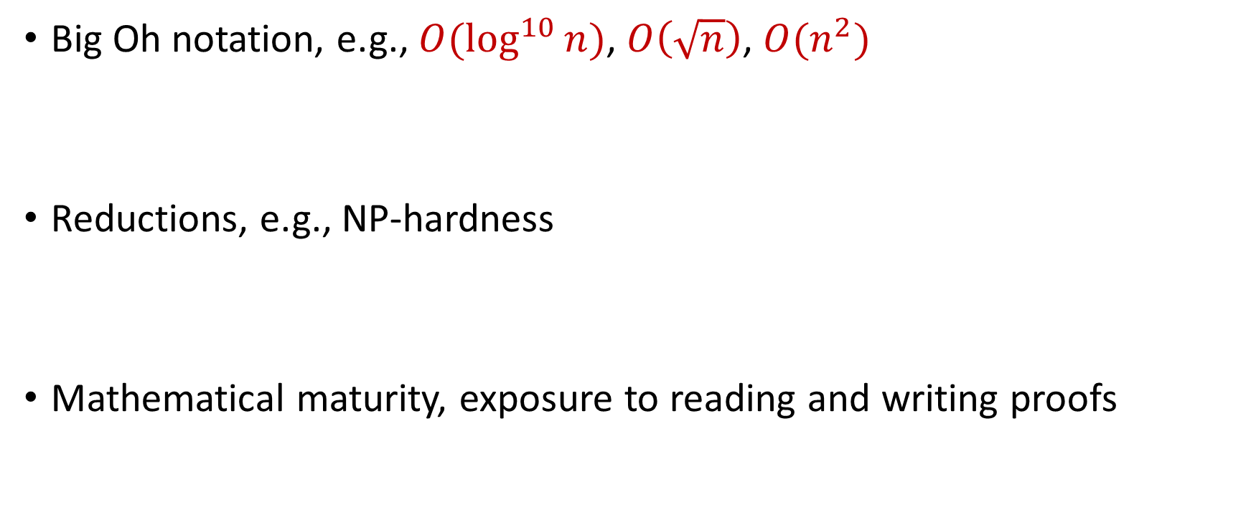
Useful Background
Big Oh notation, e.g., $O(\log^{10}{n)}$, $O\left(\sqrt{n}\right)$, $O(n^{2})$
Reductions, e.g., NP-hardness
Mathematical maturity, exposure to reading and writing proofs

Slide 23
CSCE 689: Special Topics in Modern Algorithms for Data Science
Week 1: Probability basics
Samson Zhou

Slide 24
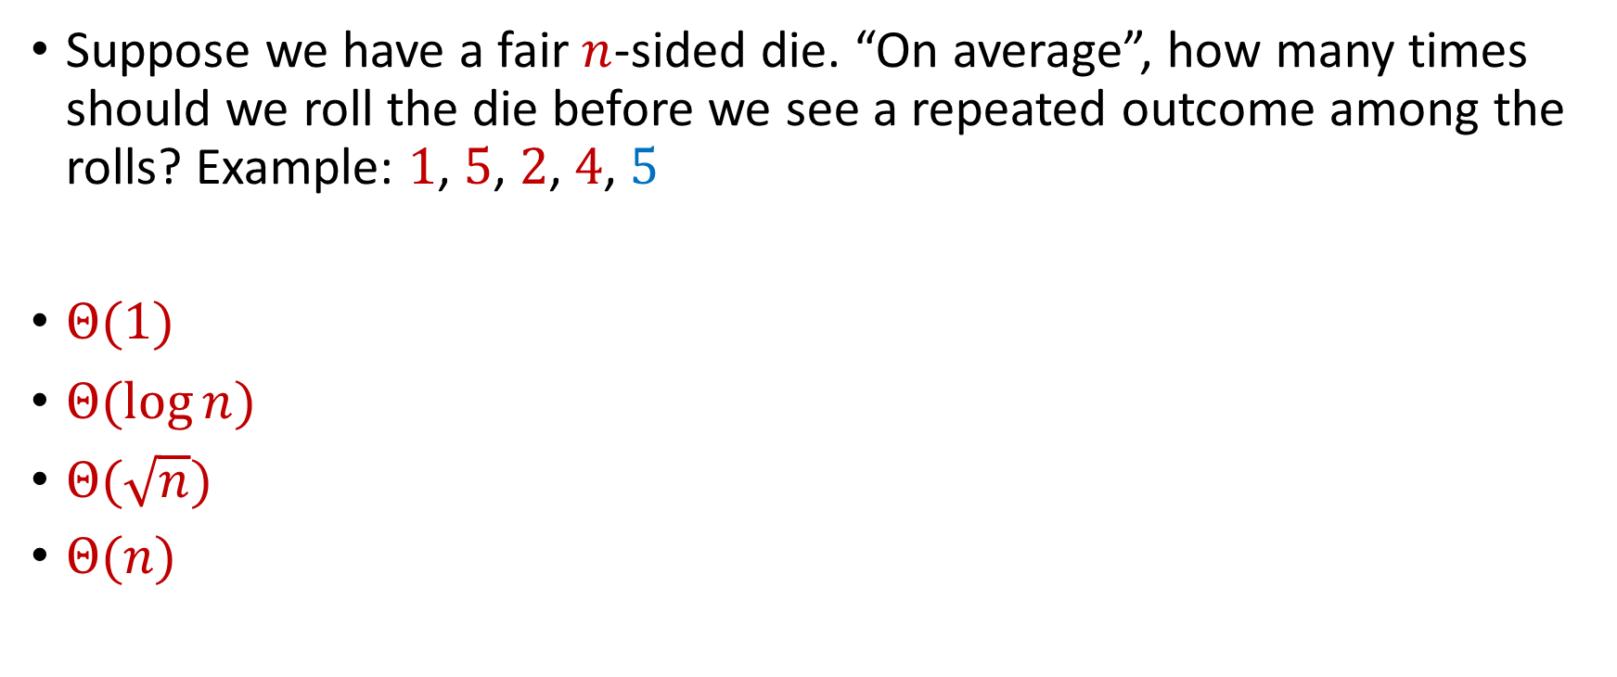
Trivia Question #1 (Birthday Paradox)
Suppose we have a fair $n$-sided die. “On average”, how many times should we roll the die before we see a repeated outcome among the rolls? Example: $1$, $5$, $2$, $4$, $5$
$Θ(1)$
$Θ(\log{n})$
$Θ(\sqrt{n})$
$Θ(n)$

Slide 25

Trivia Question #2 (Limits)
Let $c>0$ be a constant. What is $\lim_{n→∞}{\left(1−\frac{c}{n}\right)}^{n}$?
$0$
$\frac{1}{c}$
$\frac{1}{2c}$
$\frac{1}{e^{c}}$
$1$

Slide 26
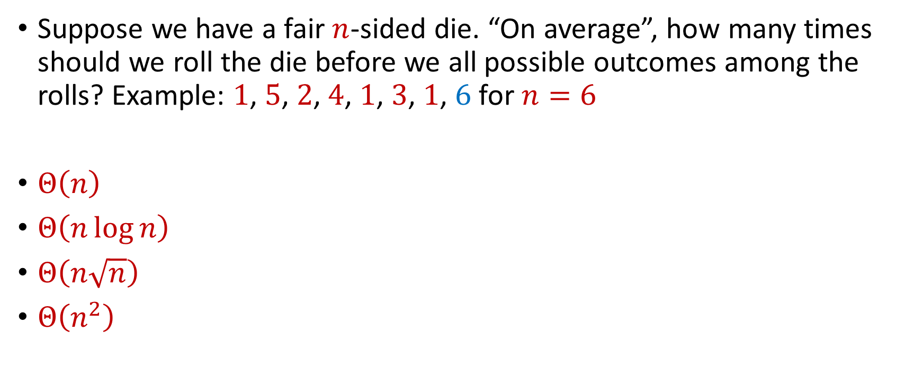
Trivia Question #3 (Coupon Collector)
Suppose we have a fair $n$-sided die. “On average”, how many times should we roll the die before we all possible outcomes among the rolls? Example: $1$, $5$, $2$, $4$, $1$, $3$, $1$, $6$ for $n=6$
$Θ\left(n\right)$
$Θ\left(n\log{n}\right)$
$Θ\left(n\sqrt{n}\right)$
$Θ\left(n^{2}\right)$

Slide 27
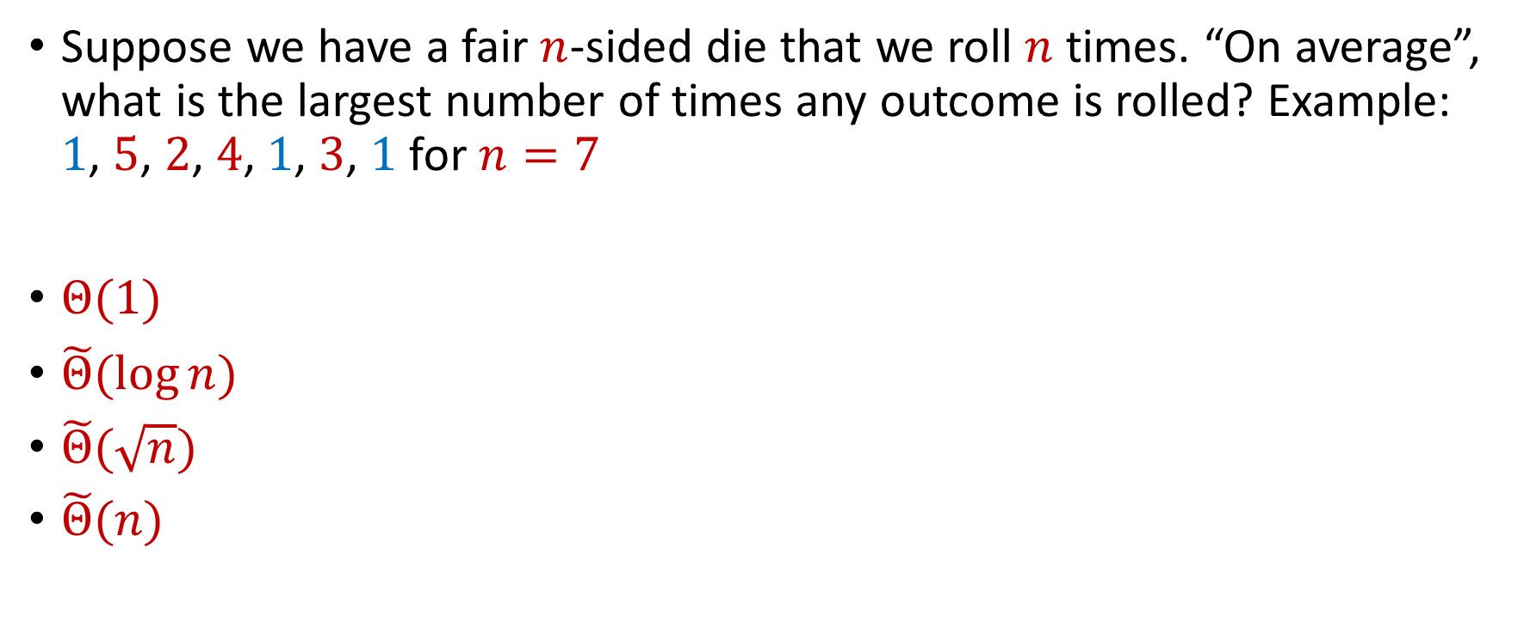
Trivia Question #4 (Max Load)
Suppose we have a fair $n$-sided die that we roll $n$ times. “On average”, what is the largest number of times any outcome is rolled? Example: $1$, $5$, $2$, $4$, $1$, $3$, $1$ for $n=7$
$Θ(1)$
$\tilde{Θ}(\log{n})$
$\tilde{Θ}(\sqrt{n})$
$\tilde{Θ}(n)$

Slide 28
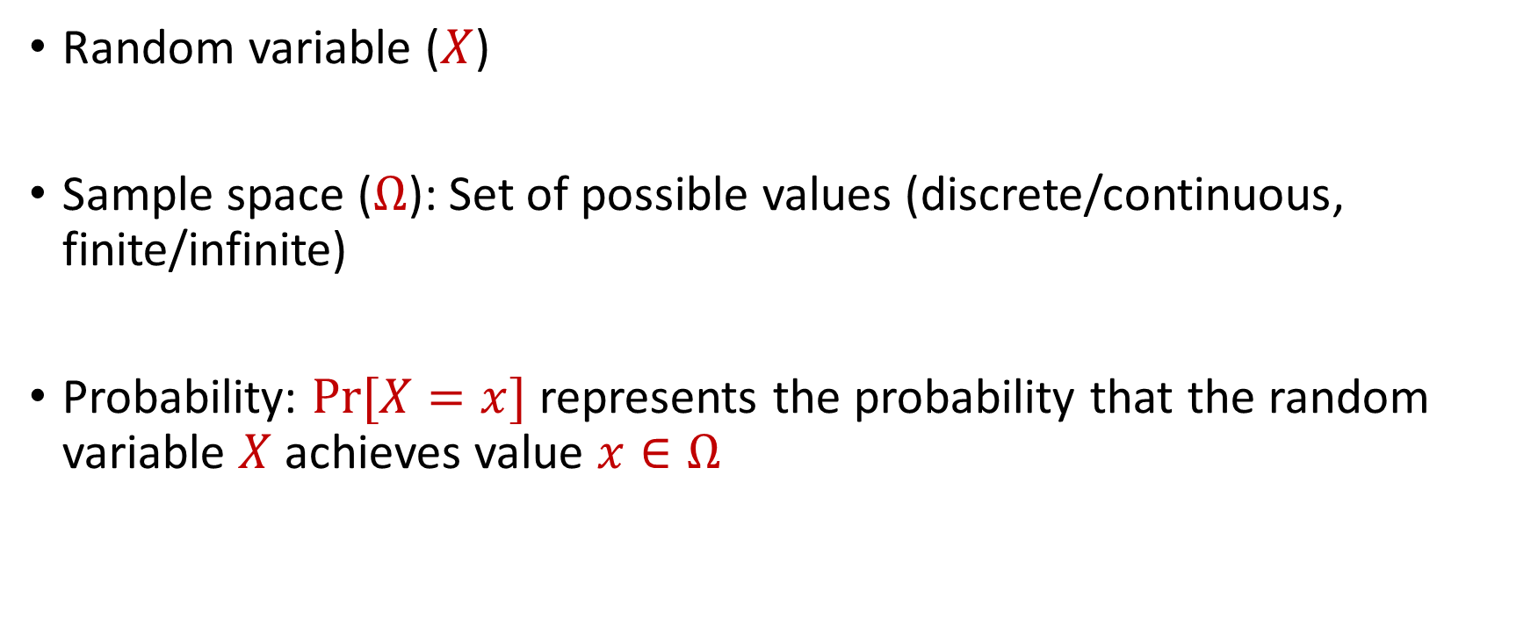
Probability Basics
Random variable ($X$)
Sample space ($Ω$): Set of possible values (discrete/continuous, finite/infinite)
Probability: $Pr[X=x]$ represents the probability that the random variable $X$ achieves value $x∈Ω$

Slide 29
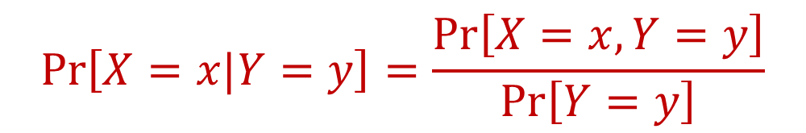
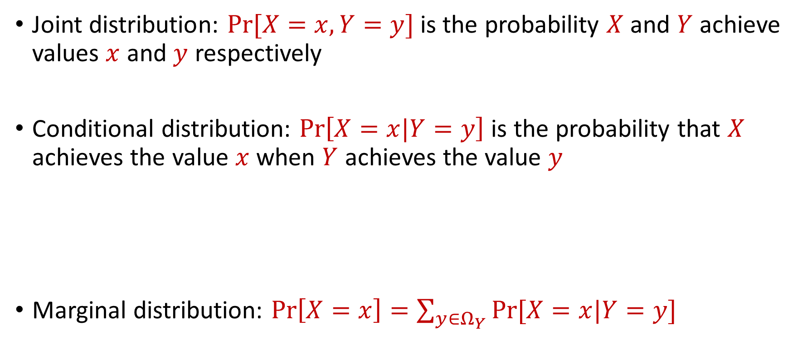
Joint and Conditional Probability
Joint distribution: $Pr[X=x, Y=y]$ is the probability $X$ and $Y$ achieve values $x$ and $y$ respectively
Conditional distribution: $Pr\left[X=x|Y=y\right]$ is the probability that $X$ achieves the value $x$when $Y$ achieves the value $y$
Marginal distribution: $Pr\left[X=x\right]=\sum_{y∈Ω_{Y}}{Pr[X=x|Y=y]}$
$$Pr\left[X=x|Y=y\right]=\frac{Pr\left[X=x, Y=y\right]}{Pr\left[Y=y\right]}$$

Slide 30

Independence
Random variables $X$ and $Y$ are independent if $Pr\left[X=x\right]=Pr\left[X=x|Y=y\right]$ for all possible outcomes $x∈Ω_{X}$, $y∈Ω_{Y}$

Slide 31

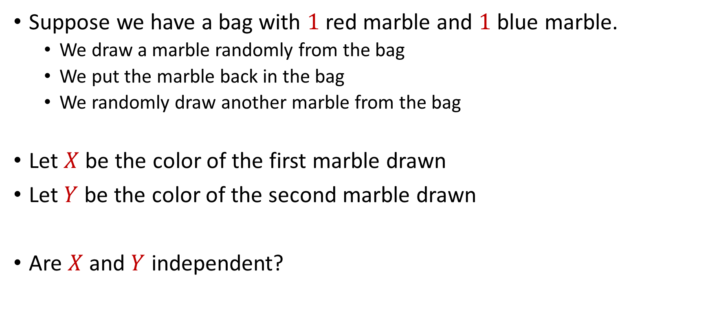
Independence
Suppose we have a bag with $1$ red marble and $1$ blue marble.
We draw a marble randomly from the bag
We put the marble back in the bag
We randomly draw another marble from the bag
Let $X$ be the color of the first marble drawn
Let $Y$ be the color of the second marble drawn
Are $X$ and $Y$ independent?

Slide 32

Independence
Suppose we have a bag with $1$ red marble and $1$ blue marble.
We draw a marble randomly from the bag
We DO NOT put the marble back in the bag
We randomly draw another marble from the bag
Let $X$ be the color of the first marble drawn
Let $Y$ be the color of the second marble drawn
Are $X$ and $Y$ independent?

Slide 33

Birthday Paradox
Suppose we have a room with $367$ people. What is the probability that two people share the same birthday?

Slide 34
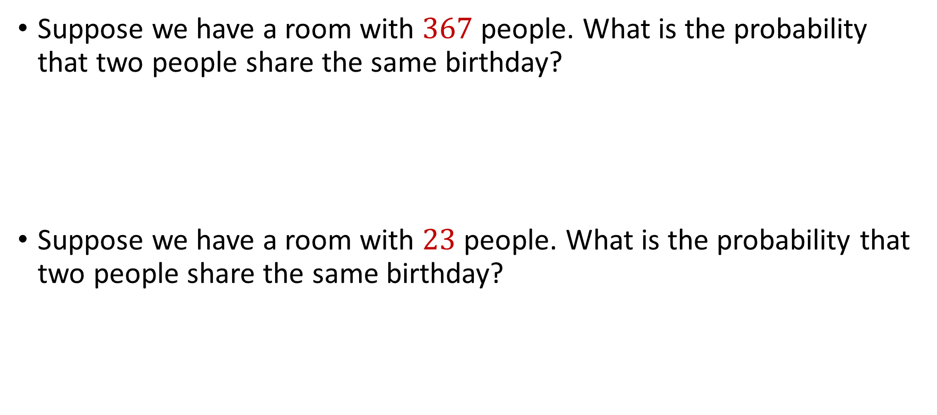
Birthday Paradox
Suppose we have a room with $367$ people. What is the probability that two people share the same birthday?
Suppose we have a room with $23$ people. What is the probability that two people share the same birthday?

Slide 35

Birthday Paradox
Suppose we have a fair $n$-sided die that we roll $k=1\text{,} 2\text{, }3\text{, }4\text{,}\text{...}$ times. What is the probability we see a repeated outcome among the rolls?

Slide 36

Birthday Paradox
Suppose we have a fair $n$-sided die that we roll $k=1\text{,} 2\text{, }3\text{, }4\text{,}\text{...}$ times. What is the probability we see a repeated outcome among the rolls?
$$\left(1−\frac{0}{n}\right)$$

Slide 37

Birthday Paradox
Suppose we have a fair $n$-sided die that we roll $k=1\text{,} 2\text{, }3\text{, }4\text{,}\text{...}$ times. What is the probability we see a repeated outcome among the rolls?
$$\left(1−\frac{0}{n}\right)\left(1−\frac{1}{n}\right)$$

Slide 38
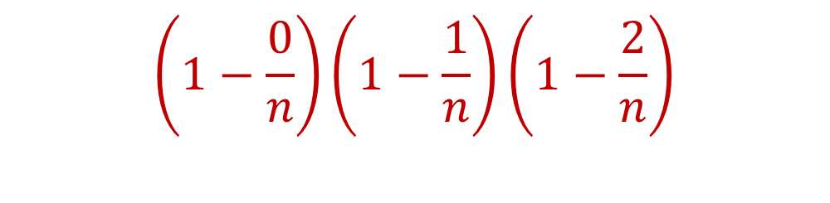
Birthday Paradox
Suppose we have a fair $n$-sided die that we roll $k=1\text{,} 2\text{, }3\text{, }4\text{,}\text{...}$ times. What is the probability we see a repeated outcome among the rolls?
$$\left(1−\frac{0}{n}\right)\left(1−\frac{1}{n}\right)\left(1−\frac{2}{n}\right)$$

Slide 39
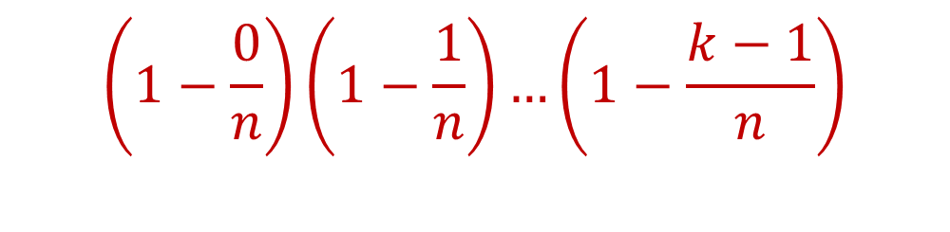
Birthday Paradox
Suppose we have a fair $n$-sided die that we roll $k=1\text{,} 2\text{, }3\text{, }4\text{,}\text{...}$ times. What is the probability we see a repeated outcome among the rolls?
$$\left(1−\frac{0}{n}\right)\left(1−\frac{1}{n}\right)…\left(1−\frac{k−1}{n}\right)$$

Slide 40
Birthday Paradox
Suppose we have a fair $n$-sided die that we roll $k=1\text{,} 2\text{, }3\text{, }4\text{,}\text{...}$ times. What is the probability we see a repeated outcome among the rolls?
$\left(1−\frac{0}{n}\right)\left(1−\frac{1}{n}\right)…\left(1−\frac{k−1}{n}\right)<\frac{1}{2}$ for $k=O(\sqrt{n})$

Slide 41
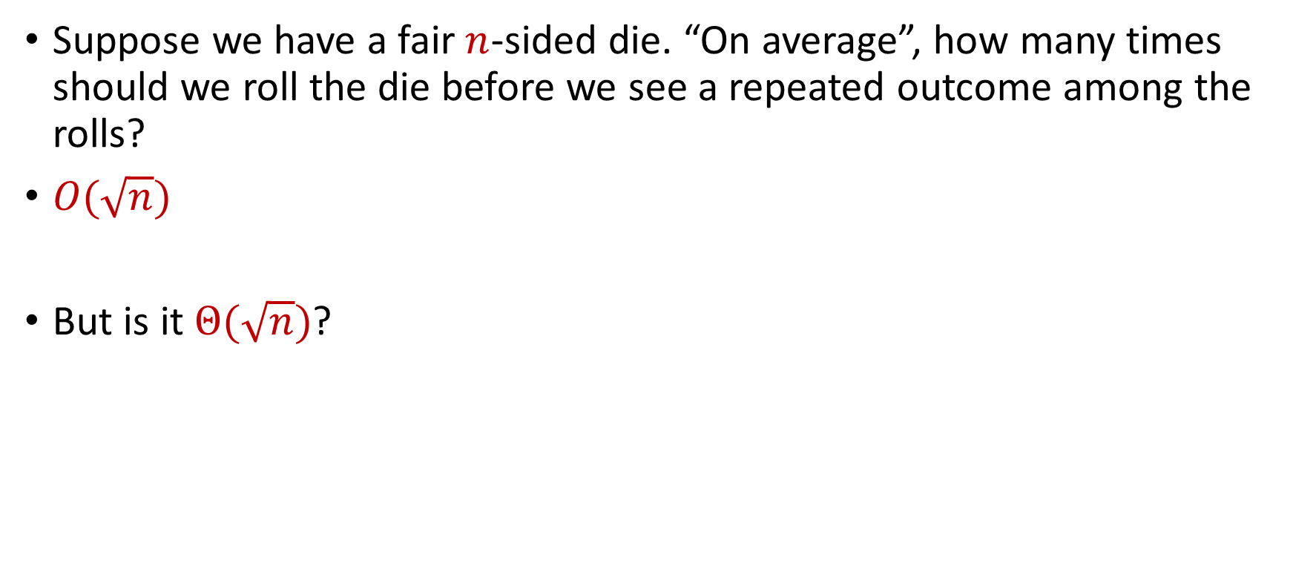
Birthday Paradox
Suppose we have a fair $n$-sided die. “On average”, how many times should we roll the die before we see a repeated outcome among the rolls?
$O(\sqrt{n})$
But is it $Θ(\sqrt{n})$?

Slide 42
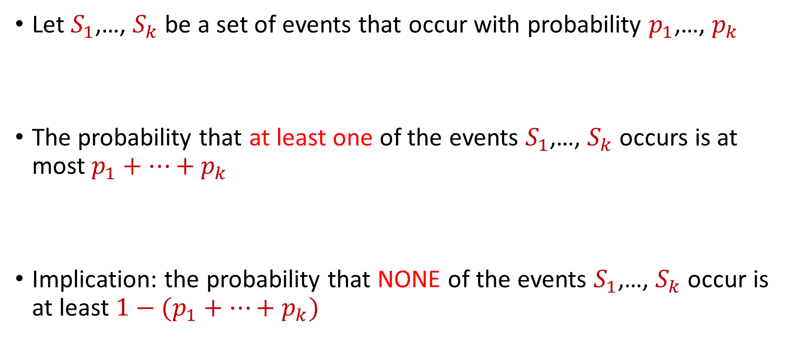
Boole’s Inequality (Union Bound)
Let $S_{1}$,…, $S_{k}$ be a set of events that occur with probability $p_{1}$,…, $p_{k}$
The probability that at least one of the events $S_{1}$,…, $S_{k}$ occurs is at most $p_{1}+…+p_{k}$
Implication: the probability that NONE of the events $S_{1}$,…, $S_{k}$ occur is at least $1−(p_{1}+…+p_{k})$

Slide 43



Boole’s Inequality (Union Bound)
$Pr\left[A∪B\right]=Pr\left[A\right]+Pr\left[B\right]−Pr\left[A∩B\right]$
Proof by induction
$$A$$
$$B$$
$$A∩B$$

Slide 44
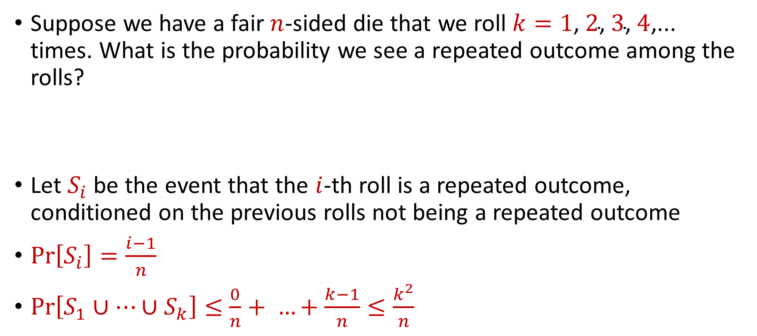
Birthday Paradox
Suppose we have a fair $n$-sided die that we roll $k=1\text{,} 2\text{, }3\text{, }4\text{,}\text{...}$ times. What is the probability we see a repeated outcome among the rolls?
Let $S_{i}$ be the event that the $i$-th roll is a repeated outcome, conditioned on the previous rolls not being a repeated outcome
$Pr\left[S_{i}\right]=\frac{i−1}{n}$
$Pr\left[S_{1}∪…∪S_{k}\right]≤$ $\frac{0}{n}+ …+\frac{k−1}{n}≤\frac{k^{2}}{n}$

Slide 45

Birthday Paradox
Suppose we have a fair $n$-sided die. “On average”, how many times should we roll the die before we see a repeated outcome among the rolls?
$Θ(\sqrt{n})$

Slide 46

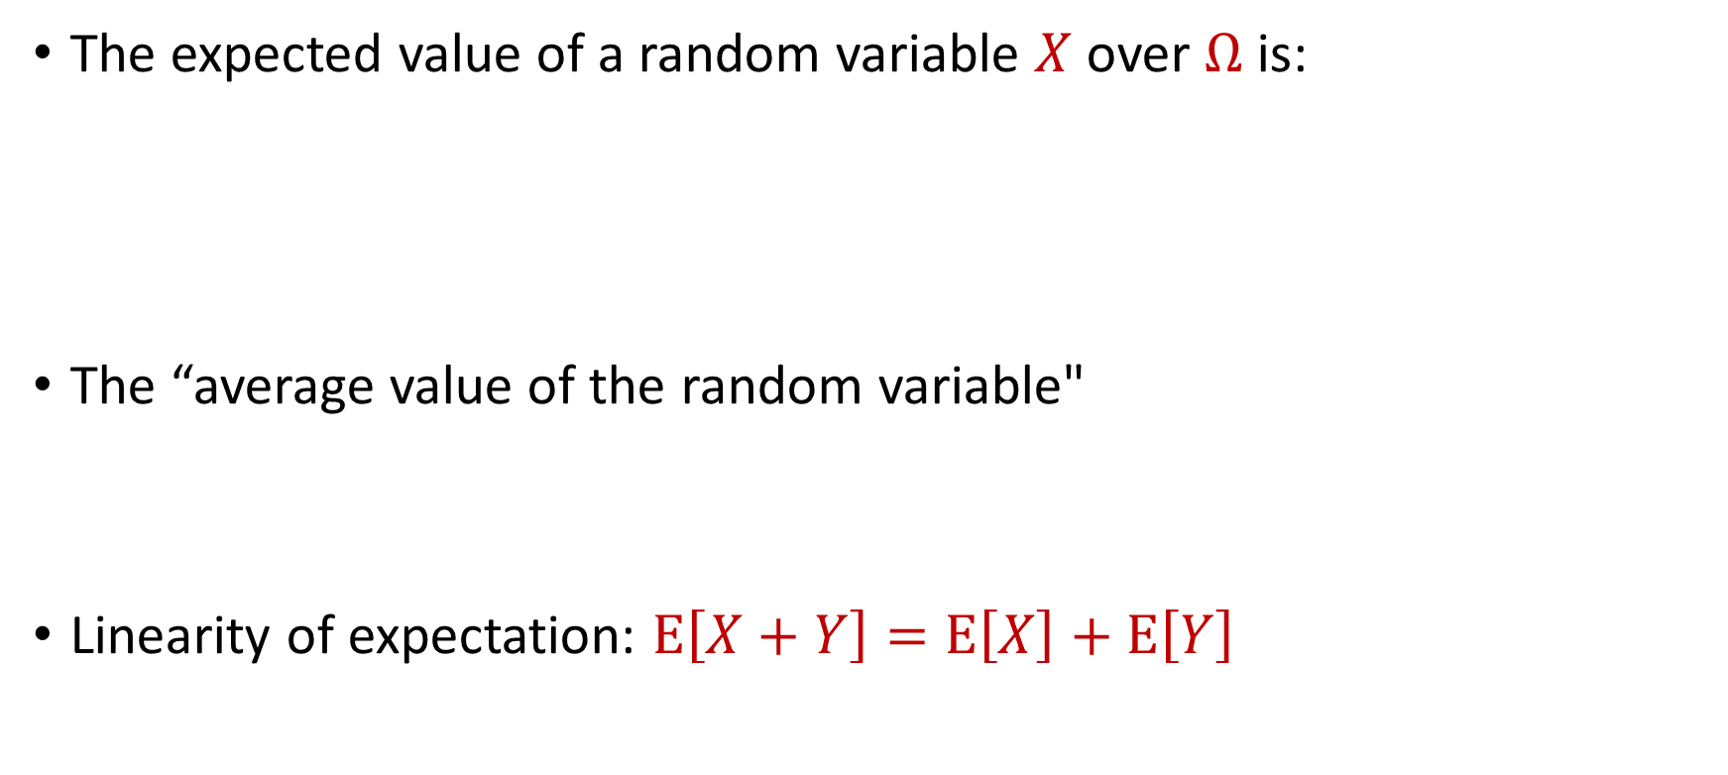
Expected Value
The expected value of a random variable $X$ over $Ω$ is:
The “average value of the random variable"
Linearity of expectation: $E\left[X+Y\right]=E\left[X\right]+E\left[Y\right]$
$$E\left[X\right]=\sum_{x∈Ω}{Pr\left[X=x\right]⋅x}$$

Slide 47

Expected Value
Suppose we roll a $6$-sided die
Let $X$ be the outcome of the roll
What is $E\left[X\right]$?

Slide 48


Moments
For $p>0$, the $p$-th moment of a random variable $X$ over $Ω$ is:
$$E\left[X^{p}\right]=\sum_{x∈Ω}{Pr\left[X=x\right]⋅x^{p}}$$

Slide 49
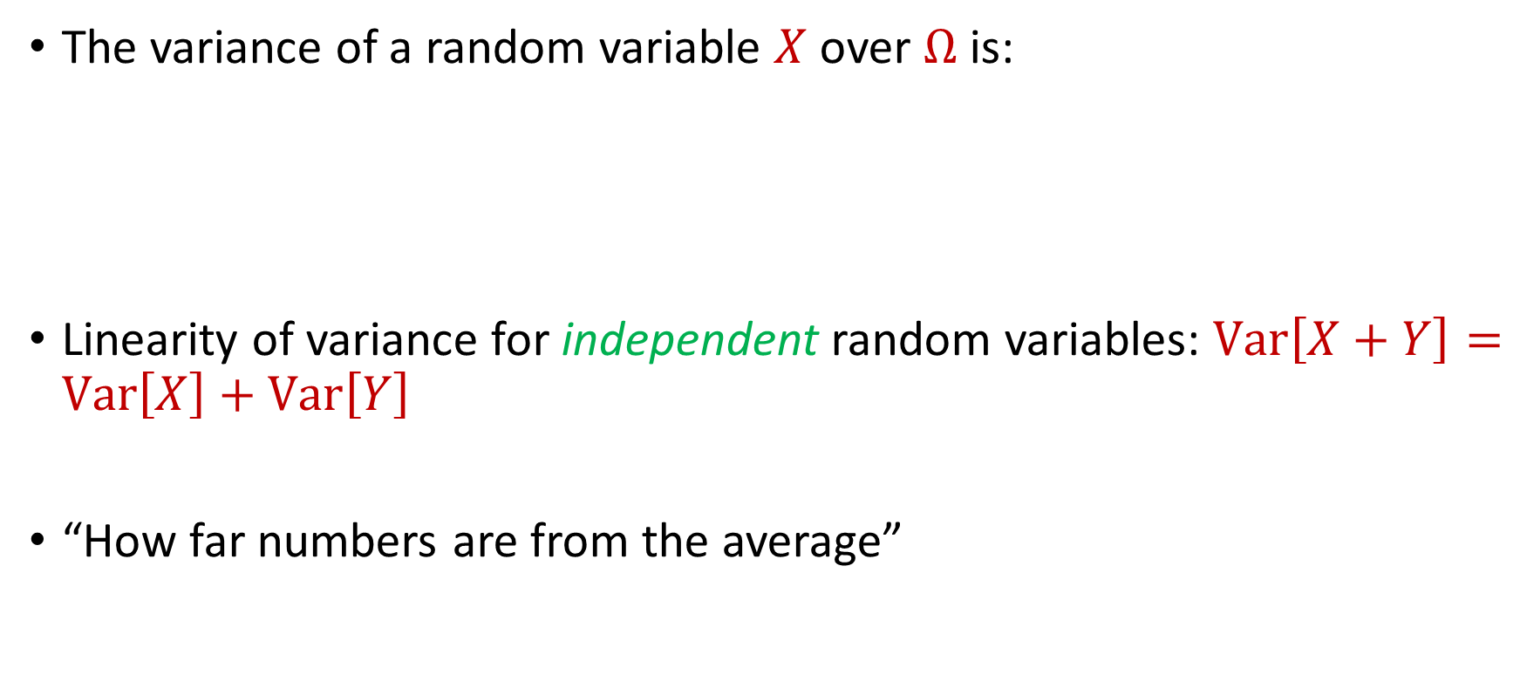
Variance
The variance of a random variable $X$ over $Ω$ is:
Linearity of variance for independent random variables: $Var\left[X+Y\right]=Var\left[X\right]+Var\left[Y\right]$
“How far numbers are from the average”
$$Var\left[X\right]=E\left[X^{2}\right]−{\left(E\left[X\right]\right)}^{2}$$

Slide 50

Variance
Suppose $X$ takes the value $1$ with probability $\frac{1}{2}$ and takes the value $−1$ with probability $\frac{1}{2}$
What is $E\left[X\right]$?
What is $Var\left[X\right]$?

Slide 51

Variance
Suppose $Y$ takes the value $100$ with probability $\frac{1}{2}$ and takes the value $−100$ with probability $\frac{1}{2}$
What is $E\left[Y\right]$?
What is $Var\left[Y\right]$?

Slide 52


Chebyshev’s Inequality
Let $X$ be a random variable with expected value $μ≔E[X]$ and variance $σ^{2}≔Var\left[X\right]$
“What is the probability a random variable is far away from its average?”
$$Pr\left[\left|X−μ\right|≥kσ\right]≤\frac{1}{k^{2}}$$

